Slide 1
How to Make a Million
Copyrighted, Kiplinger Washington Editors, Inc
Strategies for Saving at Every Age

Slide 2
At age 25, you're starting from scratch. At ages 35, 45 and 55, we assume you already have money in savings on which you're earning 8% annually. Even if you can't save quite this much now, our step-by-step guide will help you set priorities for every stage of life.

Slide 3
HOW TO SAVE A MILLION AT AGE 25
You've Saved: $0 To reach one million by age 65 you need to save $286 per month.

Slide 4
Successful Savings Strategies
You're just starting your career, so this is your chance to build a solid financial foundation. Time is on your side.
Contribute enough to your company 401(k) plan to capture your employer match. If you don't have a retirement plan at work, fund an IRA.
You'll be investing for 30 years or more, so you can afford to keep 100% of you account in stocks.
Pay down credit cards and other high-interest debt. That will free up money to save for a house.
Set up an emergency fund equal to three to six months of take-home pay. Stash it in a readily accessible account in an online bank that pays interest of 4% or more.

Slide 5
HOW TO SAVE A MILLION AT AGE 35
You've Saved: 0$ To reach one million by age 65 you need to save $671 per month.

Slide 6
If You've Saved: $50,000 To reach one million by age 65 you need to save $304 per month.
Successful Savings Strategies
You may be starting a family or preparing to buy a home. Balance you short-term needs with long-term savings goals.
Although you have added responsibilities, don't neglect retirement.
Aim to save 15% of your gross income (including an employer match in your 401(k). If one parent leaves work to care for the kids, consider opening a spousal IRA.
Shift your assets to 90% stocks and 10% bonds.
Invest in a 529 college-savings plan. Many states offer a tax deduction for your contribution, and qualified distributions are exempt from federal taxes.

Slide 7
HOW TO SAVE A MILLION AT AGE 45
You've Saved: 0$ To reach one million by age 65 you need to save $1,698 per month.

Slide 8
If You've Saved: $50,000 To reach one million by age 65 you need to save $1298 per month.
If You've Saved: $100,000 To reach one million by age 65 you need to save $861 per month.

Slide 9
Successful Savings Strategies
You may be juggling the needs of a growing family and aging parents, but don't take a break from retirement savings.
You can contribute up to $15,500 to a 401(k) or similar workplace-based retirement plan this year or $5,000 to an IRA. Roll over retirement savings from previous jobs into an IRA.
Adjust your asset allocation to 80% stocks and 20% bonds.
Your kids can get grants or loans for college, but there's no financial aid for your retirement. Don't put your kids' college costs ahead of retirement.

Slide 10
HOW TO SAVE A MILLION AT AGE 55
You've Saved: 0$ To reach one million by age 65 you need to save $5,466 per month.
If You've Saved: $50,000 To reach one million by age 65 you need to save $4,859 per month.
If You've Saved: $100,000 To reach one million by age 65 you need to save $4,253 per month.
If You've Saved: $200,000 To reach one million by age 65 you need to save $3,040 per month.

Slide 11
Successful Savings Strategies
Take advantage of your peak earning years to top off your savings.
Add an extra $5,000 in catch-up contributions to your 401(k) savings and an extra $1,000 to your IRA.
As you near retirement, reallocate your portfolio to 70% stocks and 30% bonds.
Estimate your retirement expenses and your projected income. If you're coming up short, consider working a few more years.

Slide 12
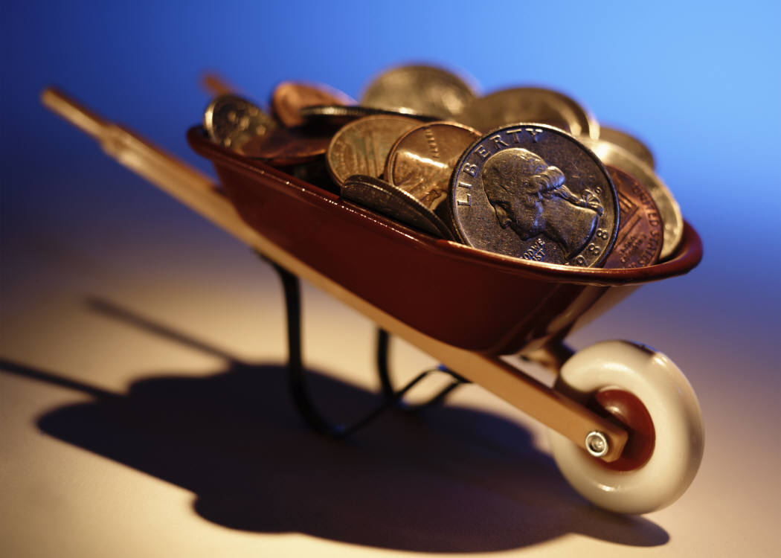
Start Saving Now

